Slide 1


Welcome to the world of HHR Digital presentation.

Slide 2
Introduction
Md Hasan Hafizur Rahman
Senior Lecturer
Department of English
Cambrian School & College
Dhaka
Class-IX-X
English First Paper
Writing Part

Slide 3
Let’s enjoy a video
What have you guessed about the video?

Slide 4
Favourite game

Slide 5
Our Today’s Lesson is-
A dialogue on
“Favourite Game”

Slide 6
Learning outcomes
After we have studied this lesson we will be able to-
know favourite game
different games
write a dialogue.

Slide 7
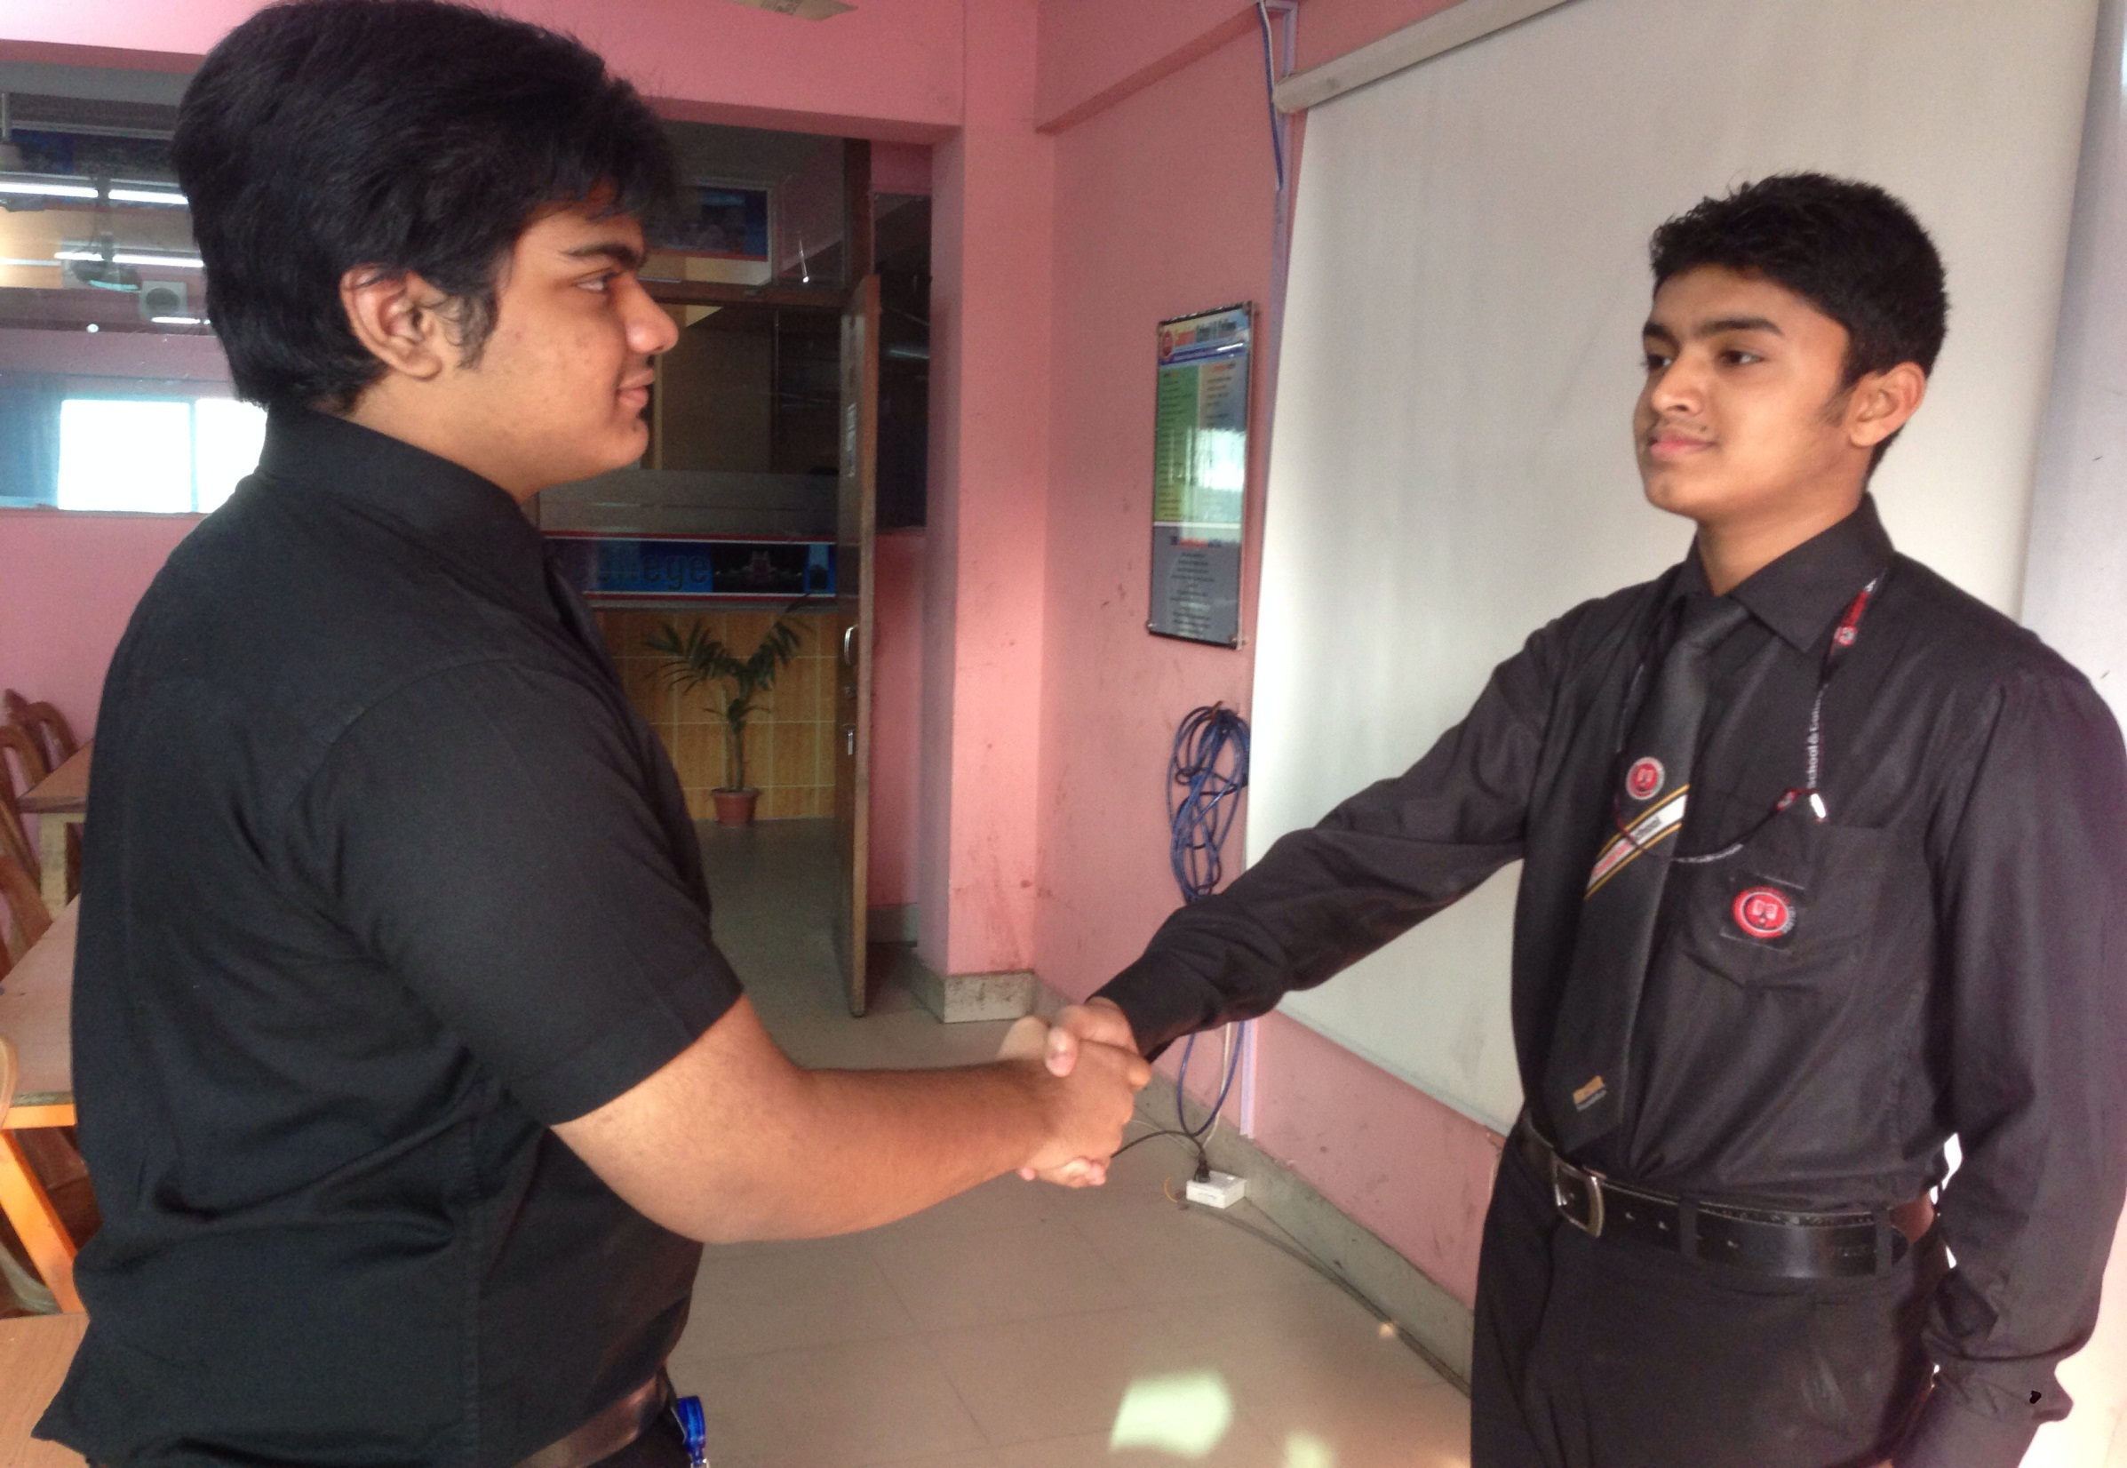
Assalamu Alaikum.
Walaikum Assalam.

Slide 8
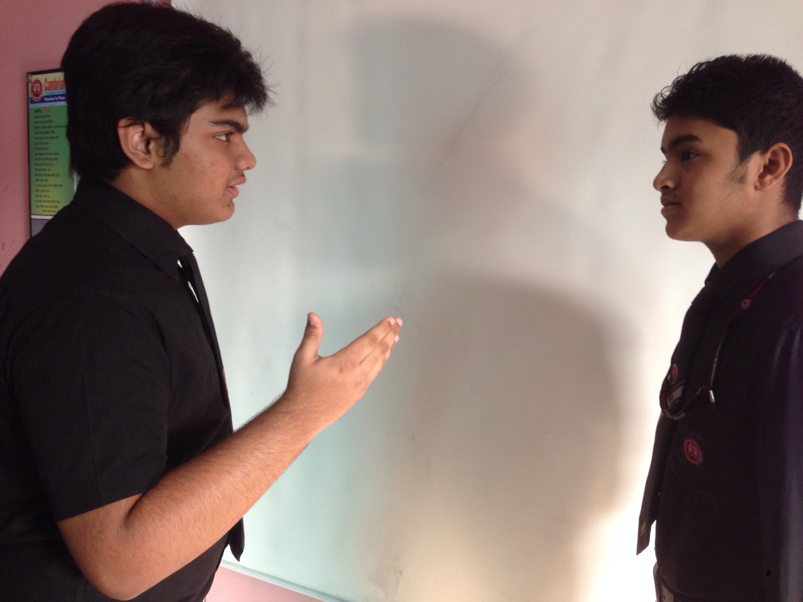
How are you my friend?
I am very excited and you?

Slide 9
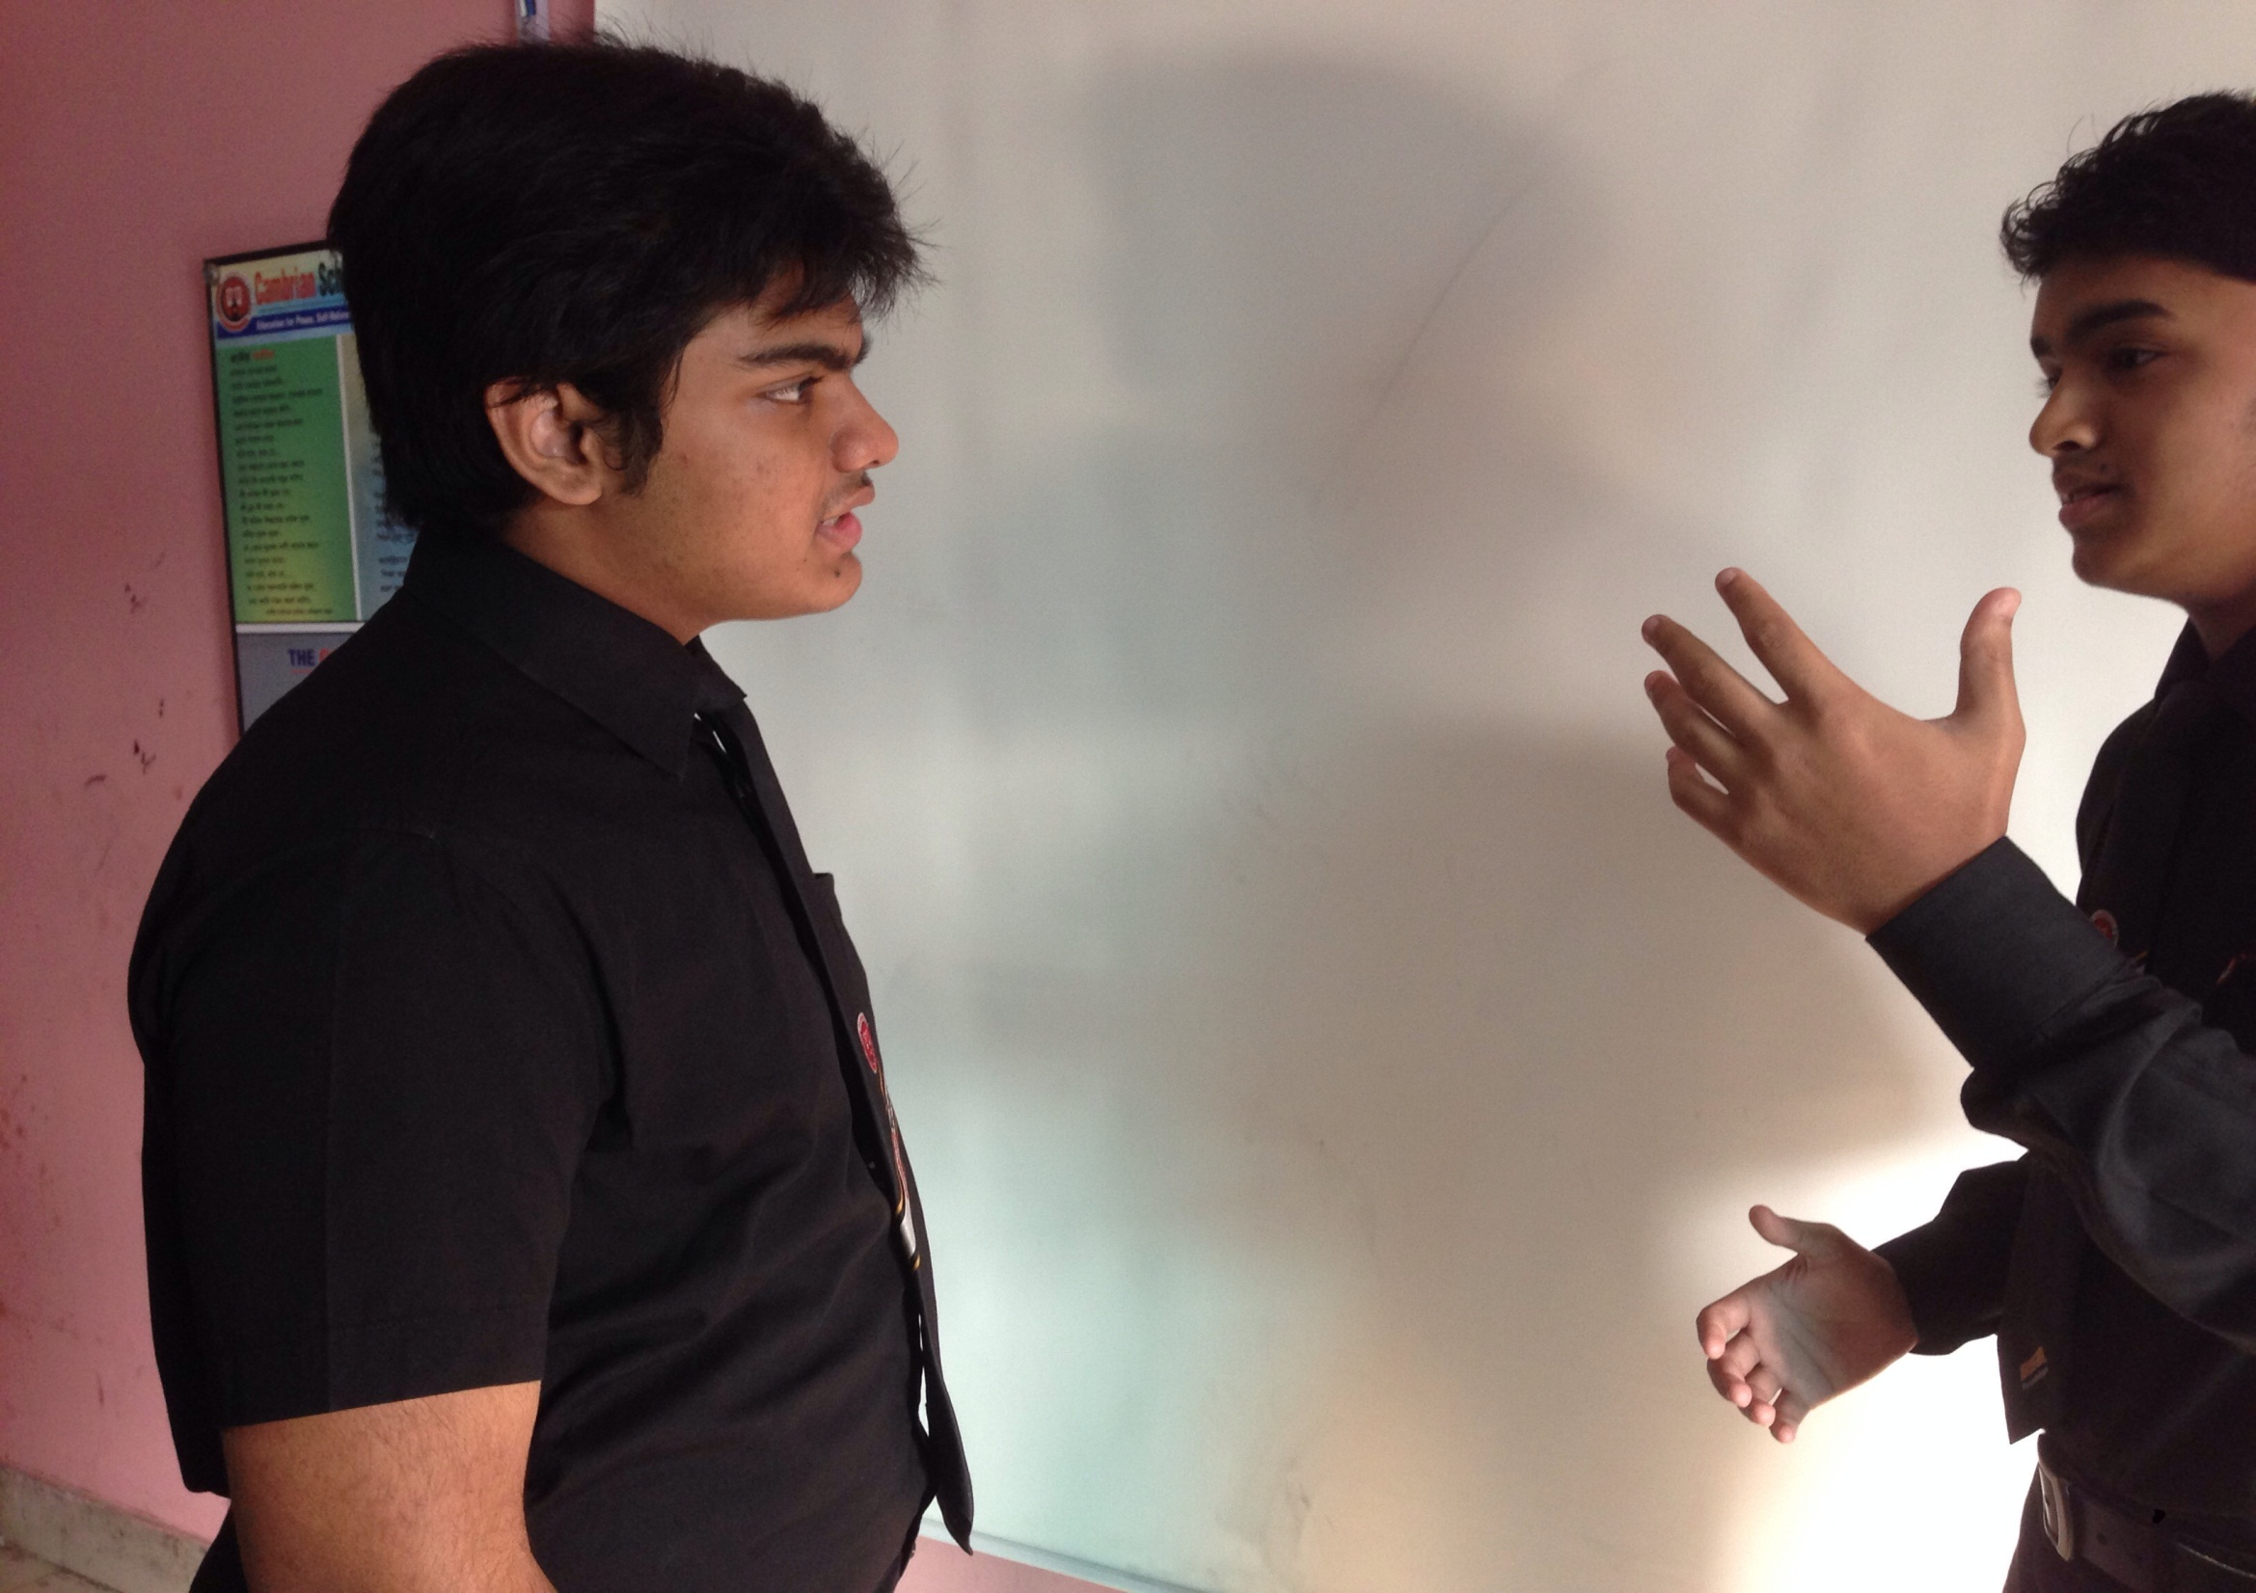
Alhamdulillah. But why are you excited?
My favourite team won the world cup football 2014.

Slide 10
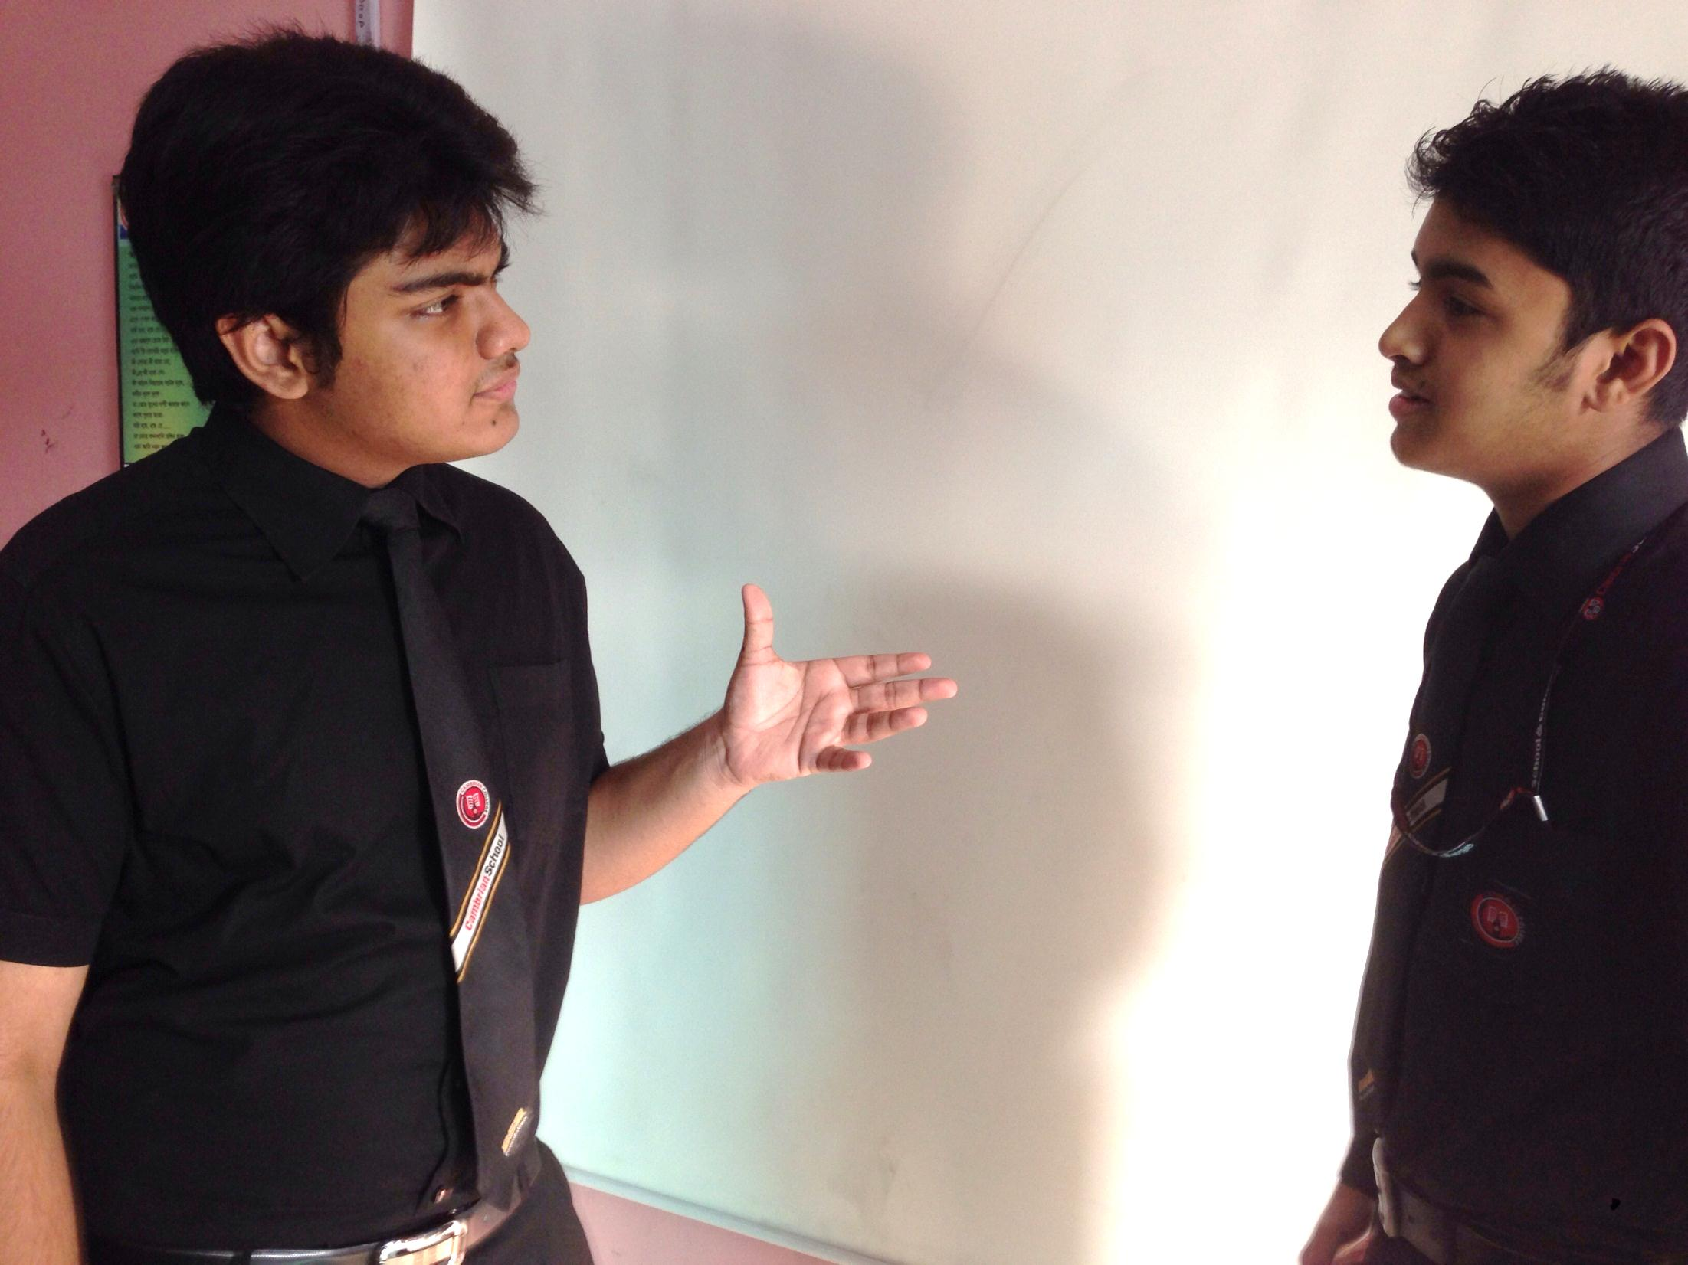
Do you like football much?
Yes, it is my favourite game.

Slide 11
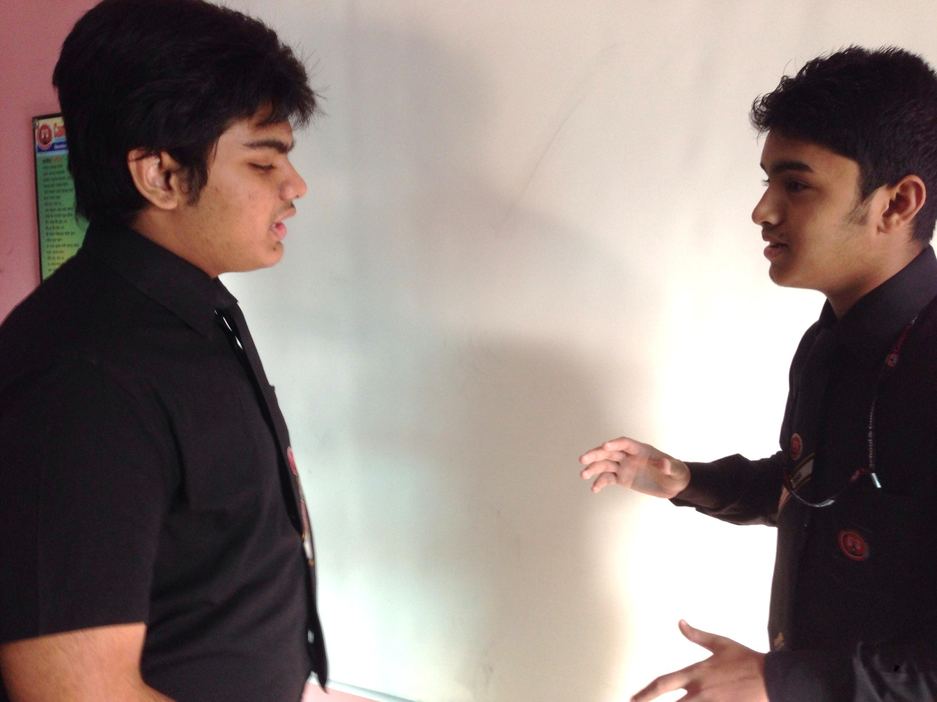
Why is football your favourite game?
I think it is very exciting.

Slide 12
Which option do you like most in the football match?
I like the pass and goal most in the football match.

Slide 13
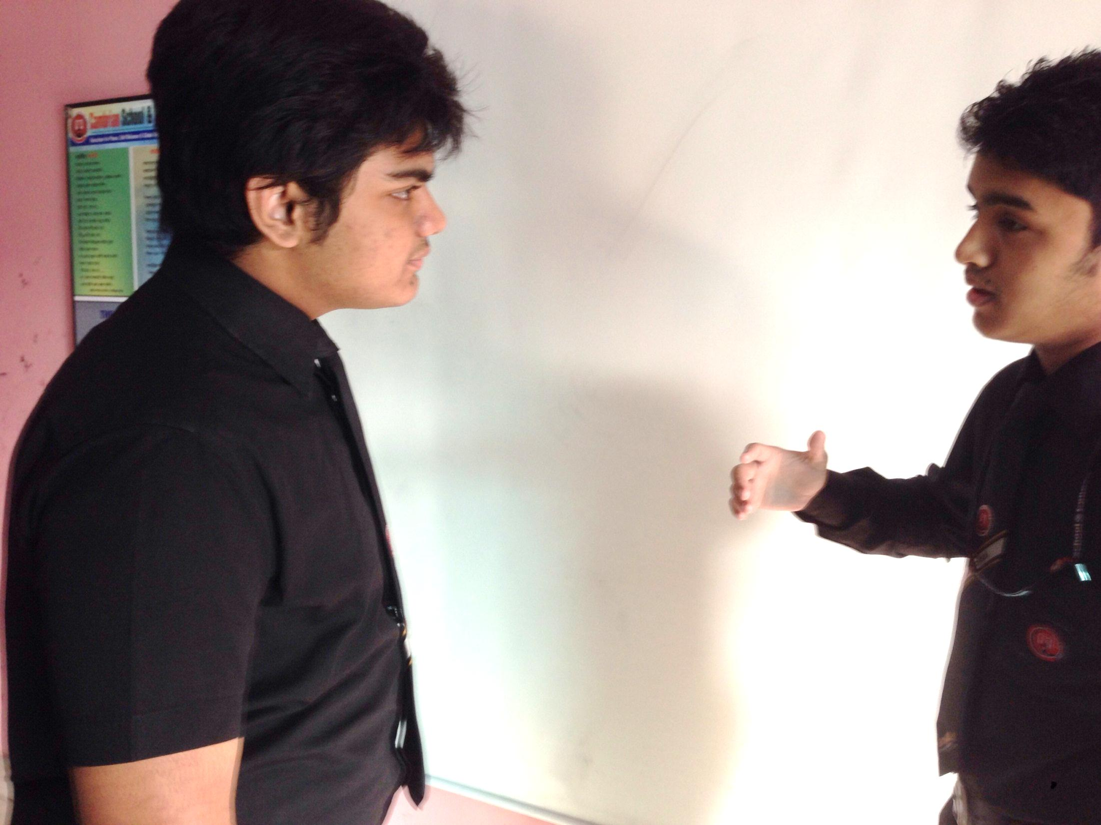
I also like football but it is not my favourite game.
What is your favourite game?

Slide 14
It is cricket.
Would you tell me why is it your favourite game?

Slide 15
Sure, bating and bowling are the main attraction of cricket match.
Yes, you are right but I think cricket is boring.

Slide 16
Why do you think so?
It takes a long time to finish a match. Very often we don’t have so much time to enjoy the game.

Slide 17
But now a day it is very popular to the people.
But I don’t think so
as it is a cool game.

Slide 18
Have you ever participated in any football match yourself?
Yes, very often I participate myself in football match in our school play ground. Do you?

Slide 19
Whenever I get an opportunity, I take part in cricket with my friends.
Actually it is very interesting
to play one’s favourite game.

Slide 20
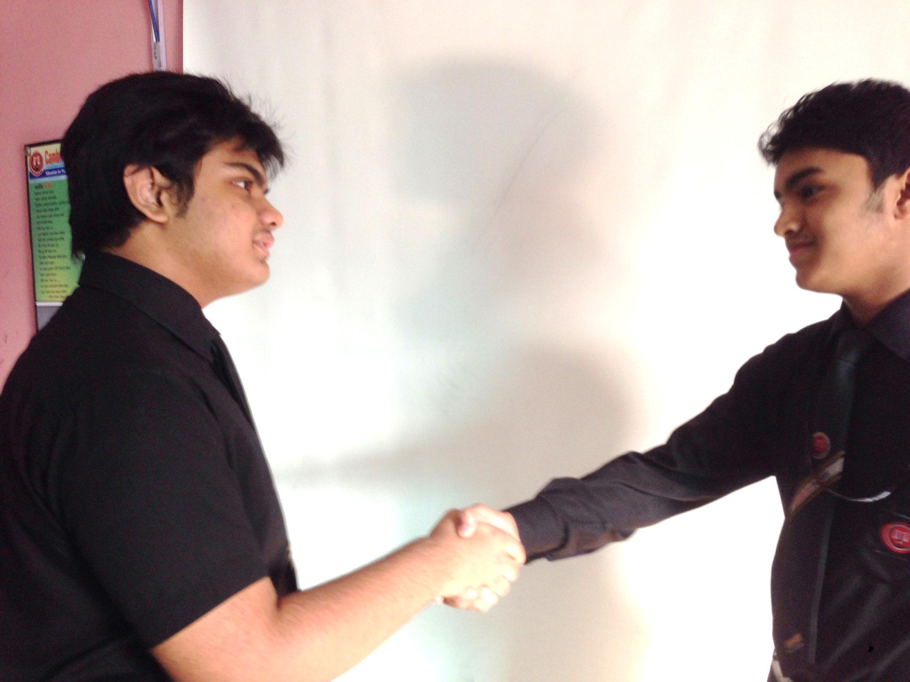
You are correct and thank you.
Thank you also.

Slide 21
Pair Work
Every single pair is suggested
to write a dialogue on,
“ Favourite Game.”

Slide 22
Evaluation
Answer the following questions-
What is favourite game?
Why is it your favourite?
Do you play it yourself?
What is the most interesting side of the game?
Where do you enjoy this game very much?

Slide 23
Homework
Write a dialogue with your friend about
“Your favourite game”

Slide 24
Verse Universal
“Game always keeps body strong and mind fresh.”

Slide 25
Fi-Amanillah
Fi-Sabilillah.

